Slide 1

Technical Presentation
Conor Orr

Slide 2

Background
The state of the Brick Union

Slide 3
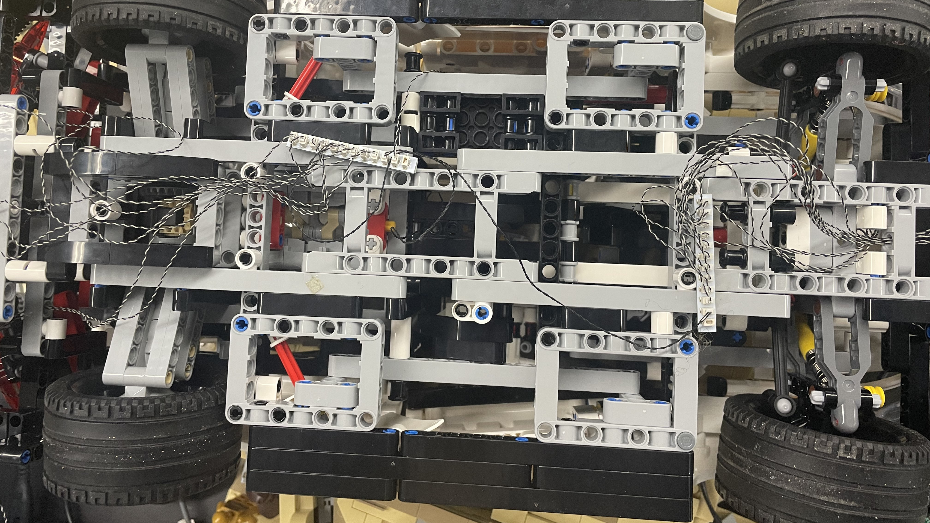
Lighting in LEGO sets

Slide 4
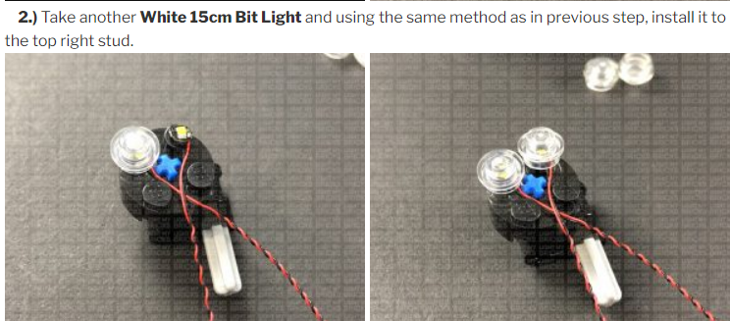
Current Instructions

Slide 5

Solution
Integration and Improvement

Slide 6
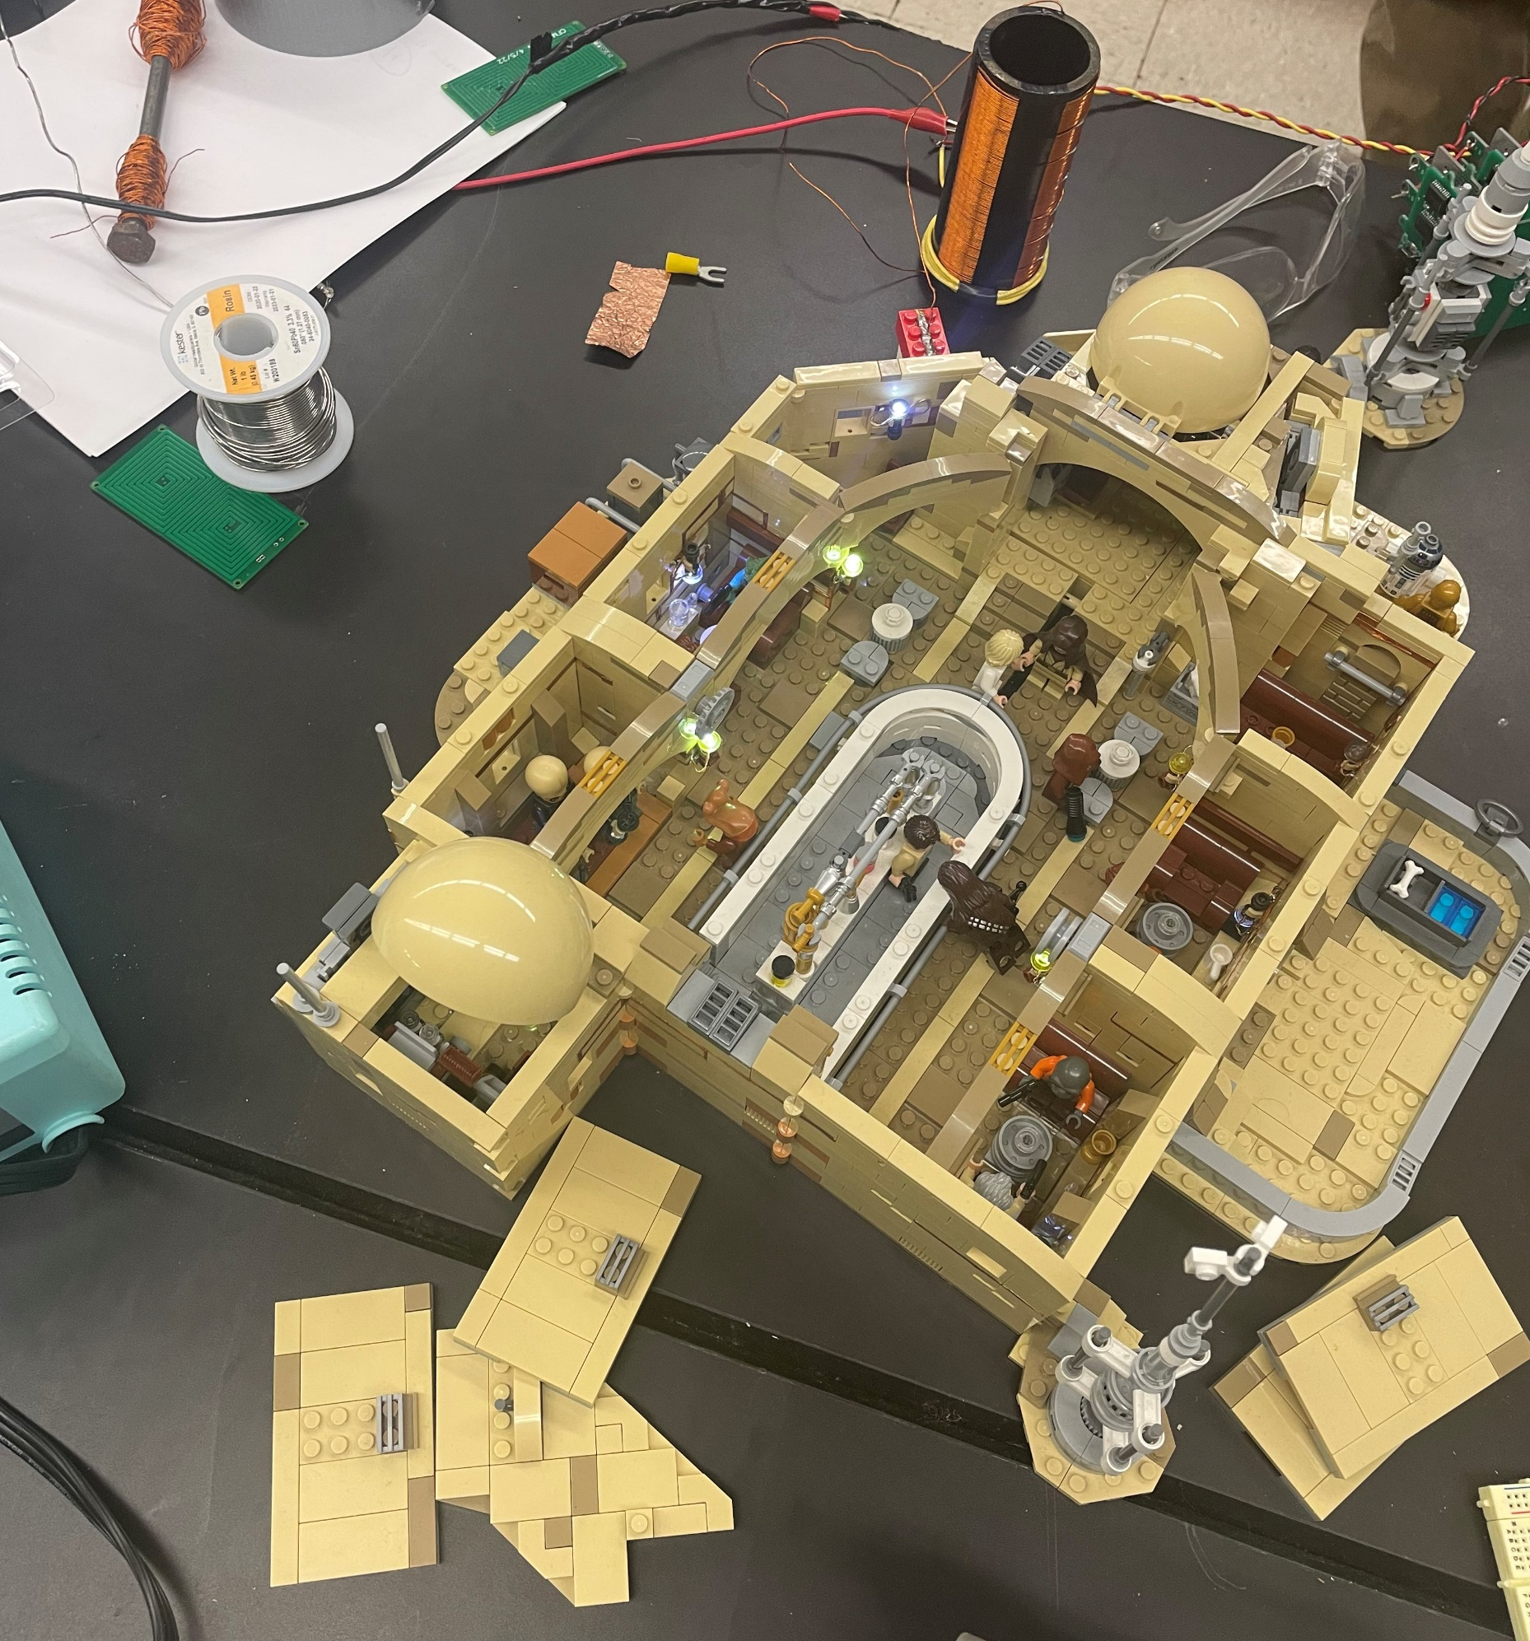
Integrating Circuitry
No wires inside the set
No batteries
Easy to follow instructions
No Disassembly

